Slide 1
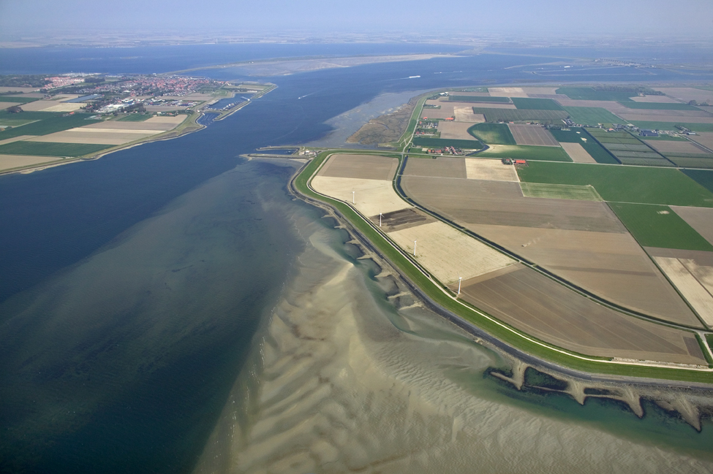


Delft-FEWS
Basic Configuration Course
(continued)
Notes:
Live System Aspects
Organising the live system
Components of a live system
Workflows - Running
Workflows – Scheduling
Triggered Workflows (het principe)
(Synchronisation)
Tool – Admin Interface:
Health Checking/Status Information
Workflow Load Balancing (mapping)
Workflow Overview (Scheduled Tasks)
Scheduling
Configuration
Configuration Manager
How Config Files/Patches are being distributed?
Optimizing the Live System
Monitoring
Configuration aspects (expiry time, synchLevel, valueResolution)
Maintenance Workflows
Amalgamate
Database Analysis
Advanced
Multi MC Systems
Duty-standby
Event-action configuration

Slide 2


Live systems (advanced)

Slide 3
Table of contents
Tools: Admin Interface
Tools: Configuration manager
Live system and configuration
Maintenance
Advanced topics

Slide 4
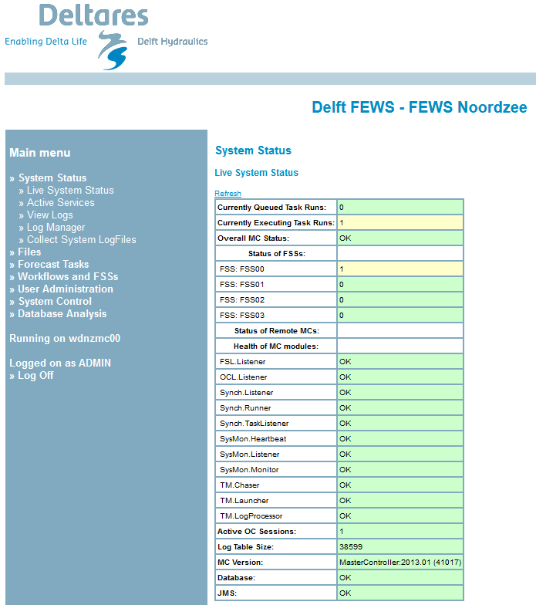
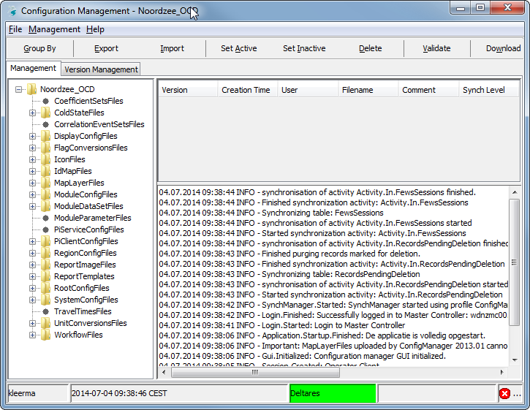
Tools operational system
Demonstration
Configuration Manager
Administrator Interface (AI)
Demonstration

Slide 5
Delft-FEWS system overview
server
client
forecasting shell(s)
configuration
manager
FSS
CM
master controller
operator client
MC
OC
admin interface
central database
AI
LDS

Slide 6
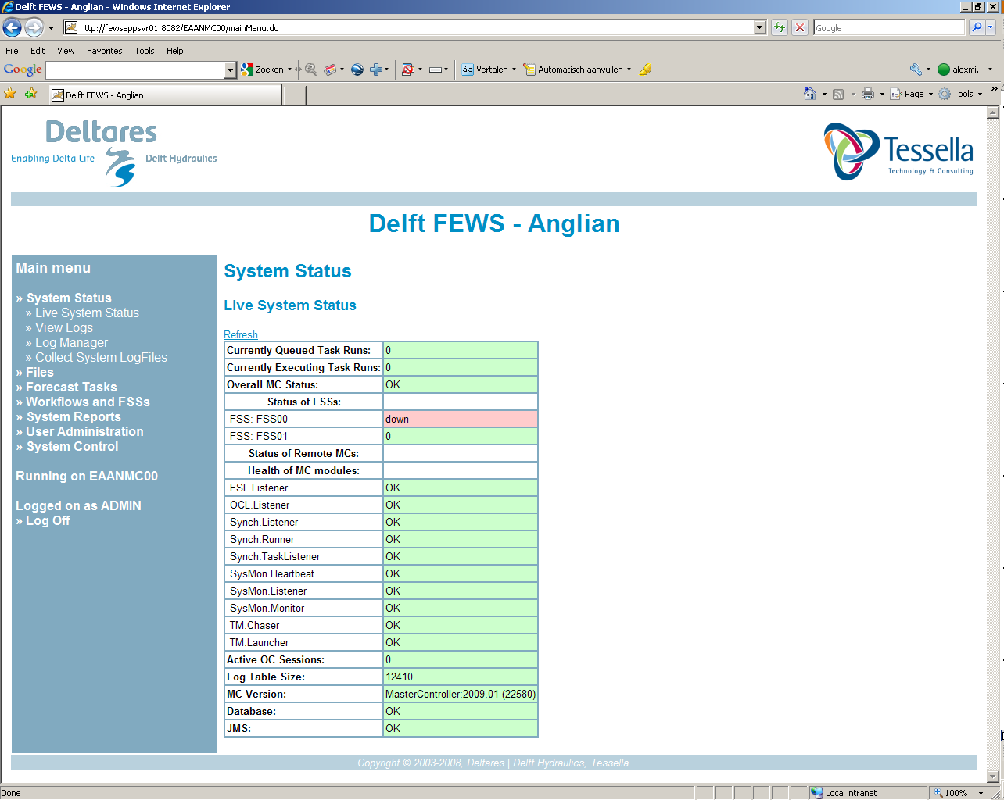
Tools – Admin Interface
Administration tool for live system
Direct access to Master Controller
Main tasks
Monitoring (health) of live system components
Scheduling of tasks (current!)
Monitoring of task queues
Management of Forecasting Shell Servers
Monitoring Data Feeds
Setting enhanced forecasting etc.

Slide 7
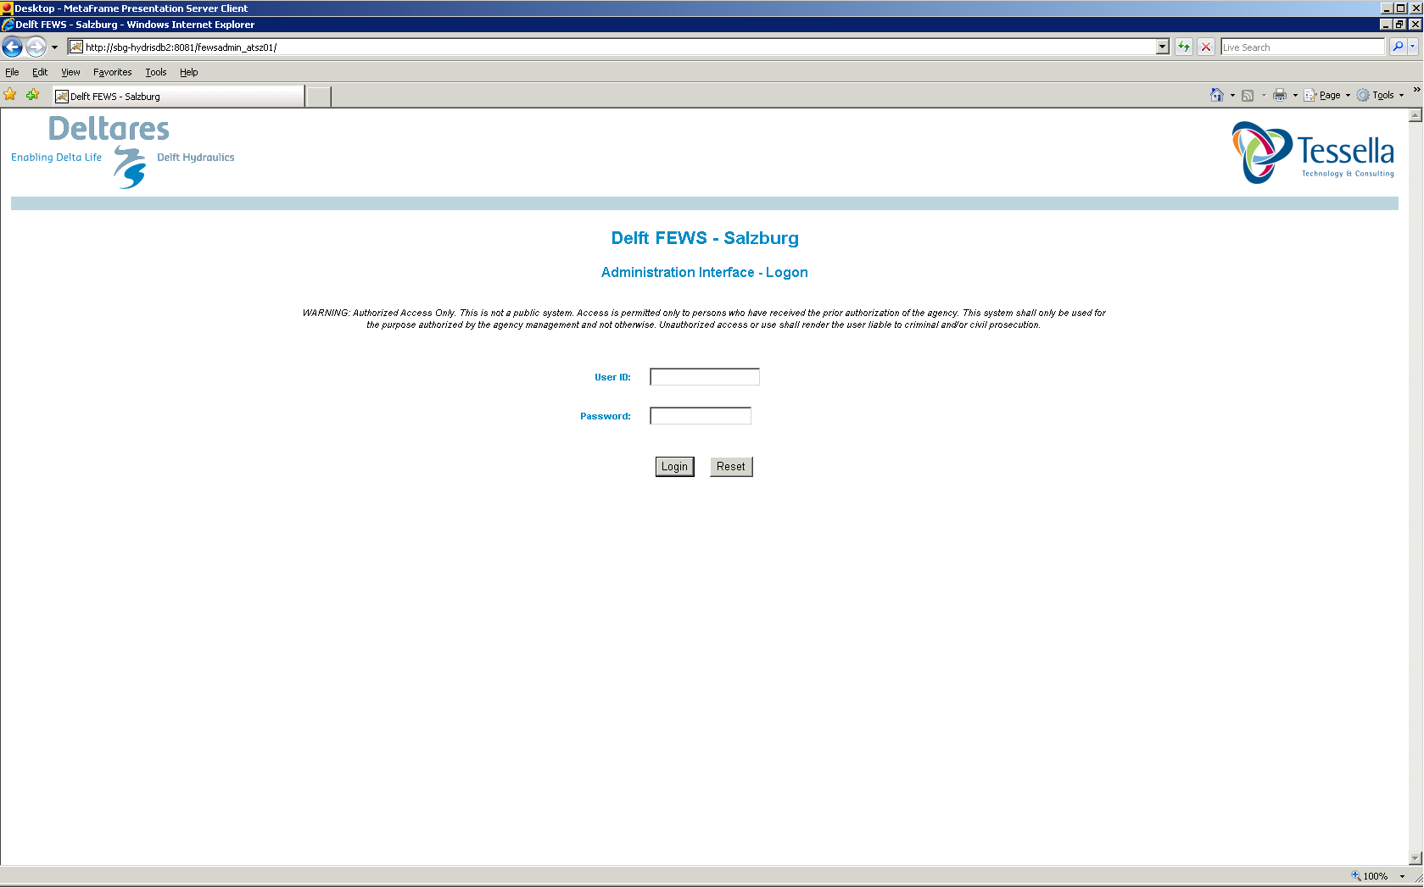
Logging in

Slide 8
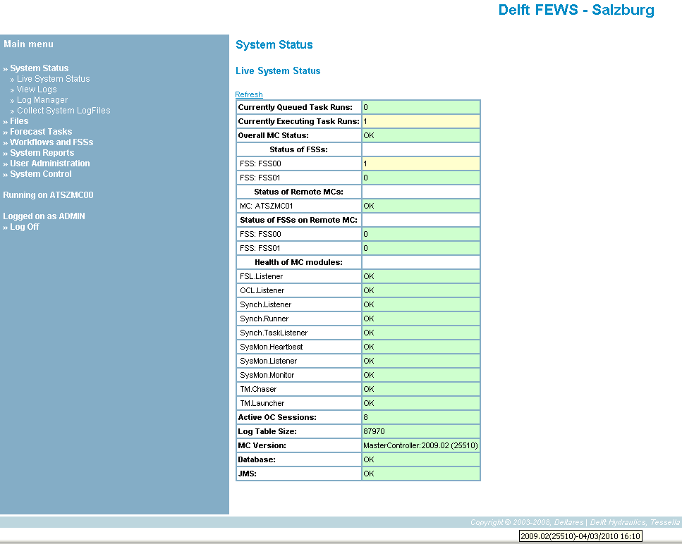
System Status
Overview of all central / vital components
Task Queues
MC Status
Forecasting Shell Servers
MC-Components
MC Version
DB Status
JMS Status
Admin Interface Version

Slide 9
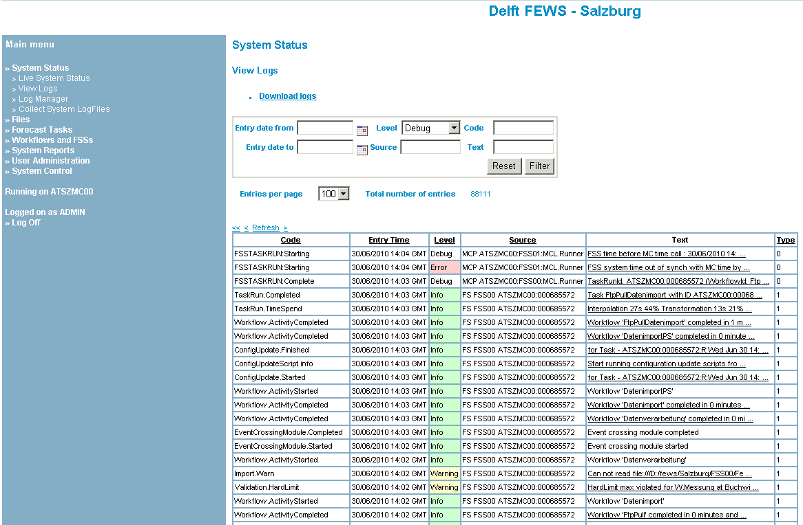
View Logs
Overview of Log messages
Master Controller
(are not displayed in OC)
(Type 0)
Forecasting Shell Server
(are also displayed in OC)
(Type 1)
Additional types:
(also displayed in OC)
Type 5 (created on OC)
Type 8 (special MC messages)

Slide 10
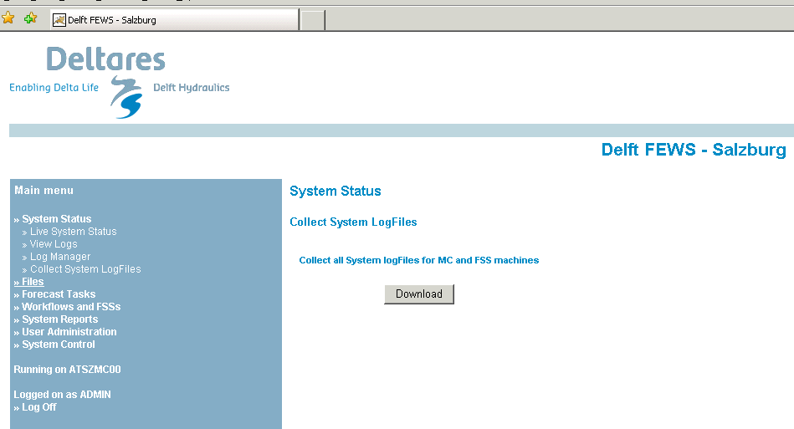
Collect system log files
Download log files from Mastercontroller, Forecasting Shells and Admin Interface as one zip file
Also provides extra information:
On disk space, server load, network connectivity (Systemreport.log)
Scheduled tasks on MC (ScheduledTasks.xml)

Slide 11
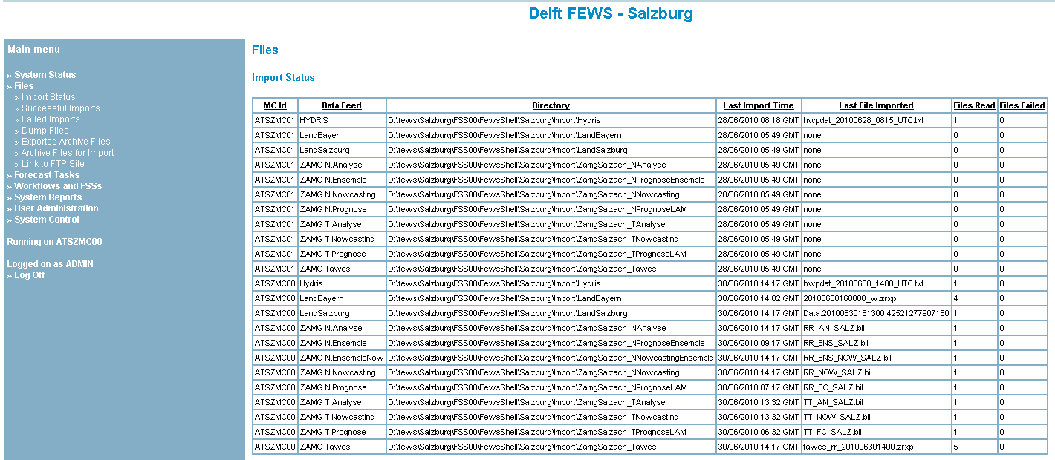
Overview of Import data
Monitor data feeds
Date / time of last import for each directory

Slide 12
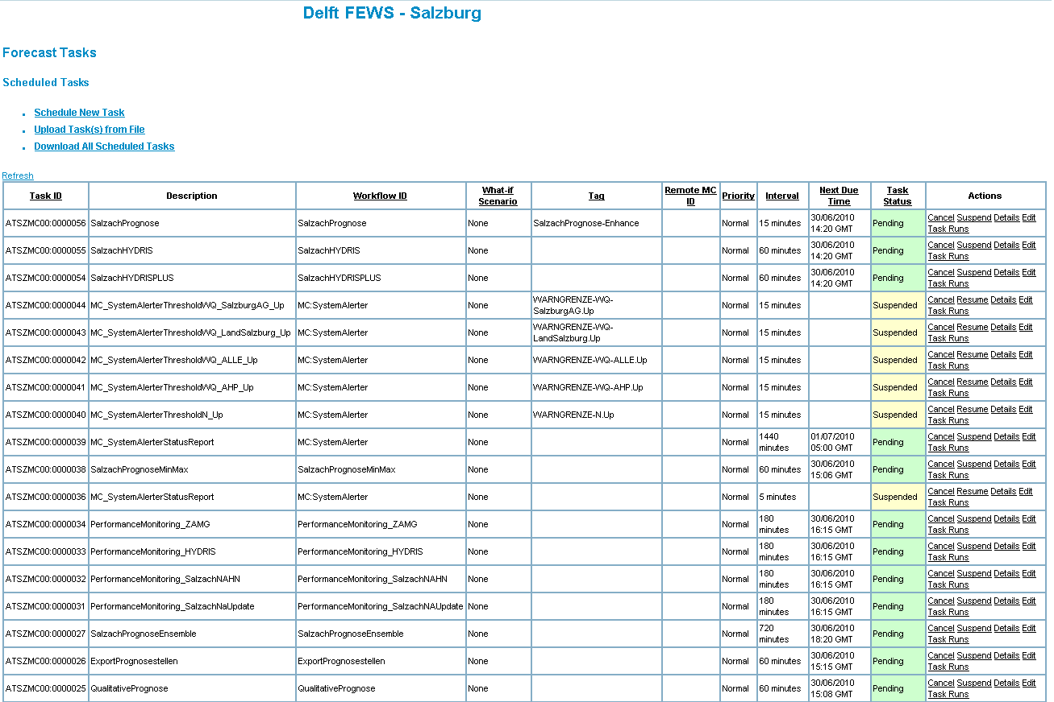
Overview of scheduled processes
- Overview of scheduled processes (“Tasks”)
- Scheduling of new processes
- Current Forecasts

Slide 13
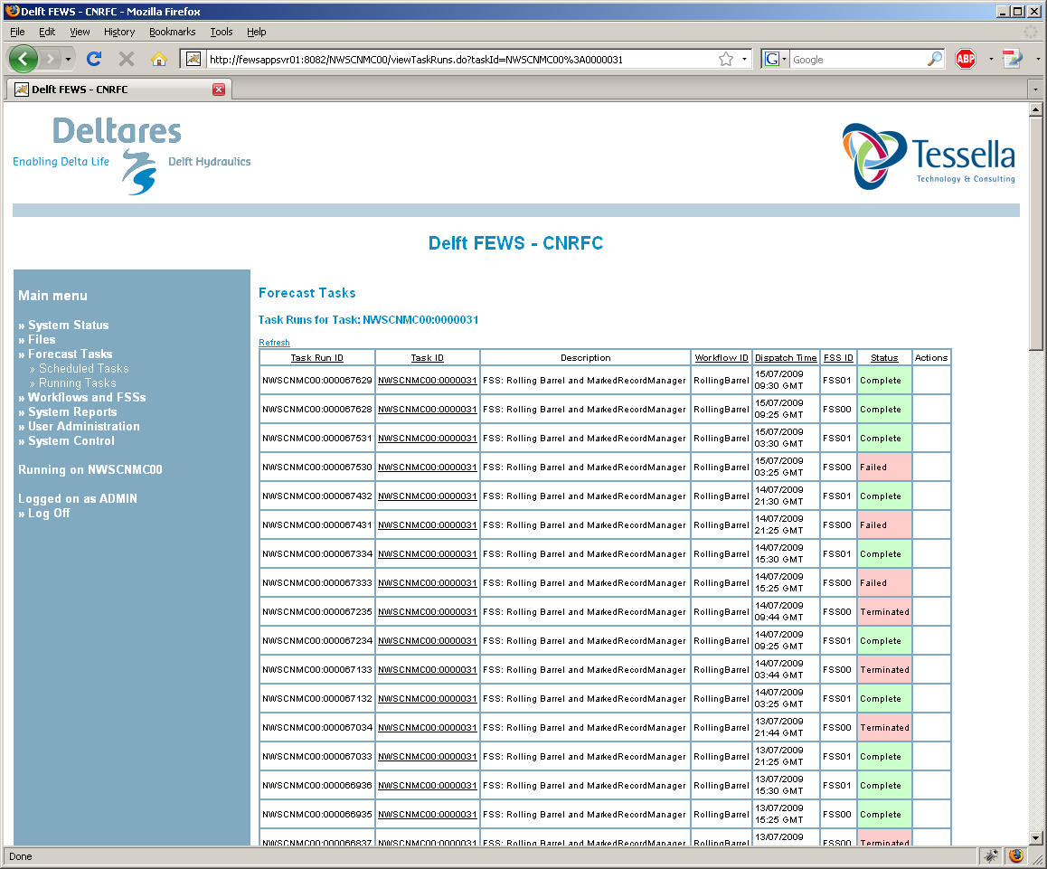
Overview executed processes
Click on “Task Runs” link of “Scheduled Task”
List of past Task executions (“Task runs”)
Display of status:
Complete
Failed
Terminated

Slide 14
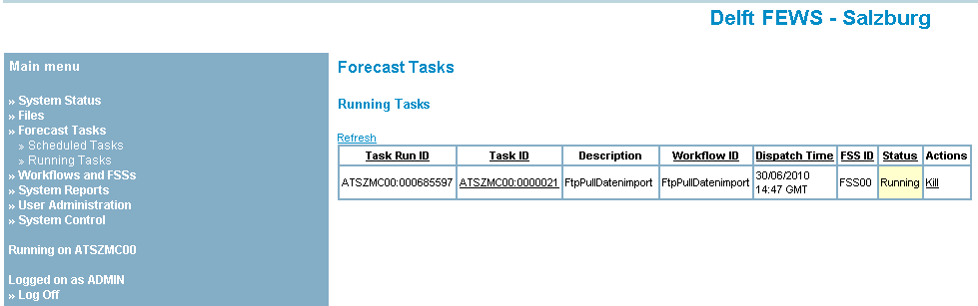
Overview of Task Queue
List of processes (“Task runs”):
running
queued
FSS-ID indicates, where the process is currently running
Manage processes
Stop/kill if desired
Processes that have been queued for 10 minutes are not executed, e.g. when no FSS is defined or available.

Slide 15
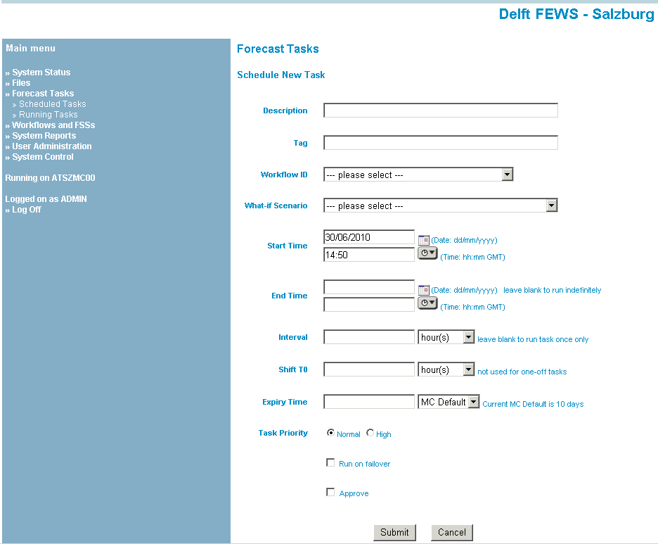
Scheduling a new task
Similar to Manual Forecast display in OC:
- Select Workflow
- Enter TAG, only for “enhanced” forecasts
- Next due time
- Repeat time (empty for single task run)
- Shift T0
- Approve (to make forecast current)
- Run on failover (not in OC)

Slide 16
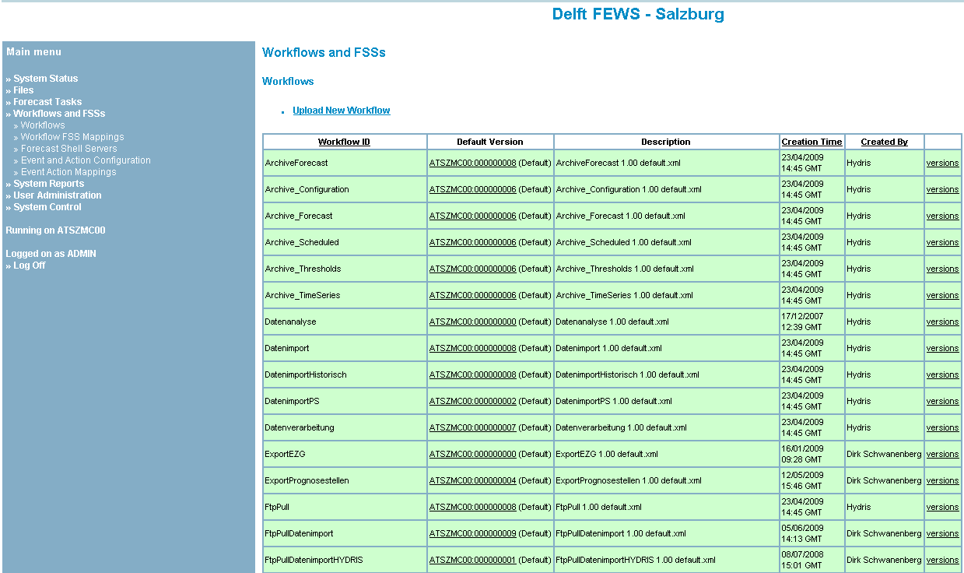
Managing Processes / Workflows
Workflows tab
- Overview of all Workflows in the central database
- Upload of new Workflows (is no longer used)

Slide 17
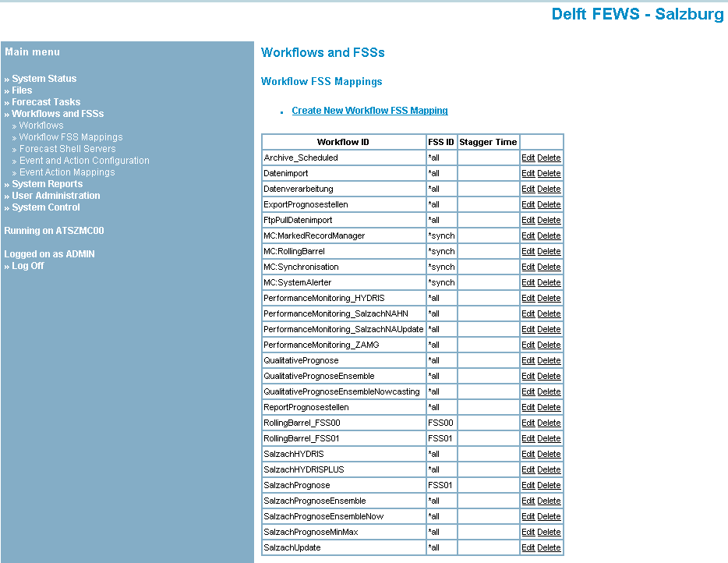
Workflow – FSS Mapping
Determines where Workflows are executed
Specific Forecasting Shell Server
Model dependent (e.g. ISIS)
FSS Rolling Barrel
One at a time
Import
MC Processes (mapped automatically)
*synch

Slide 18
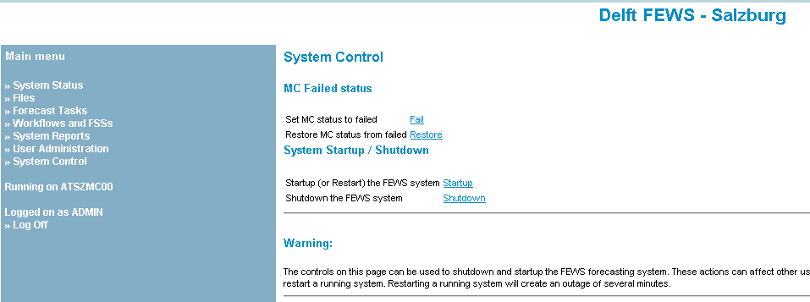
System Control
Start / Stop Master Controller
BE CAREFUL !
- Setting MC Failed status (only for systems with 2 or more MCs)
- Initiating MC startup or MC shutdown

Slide 19
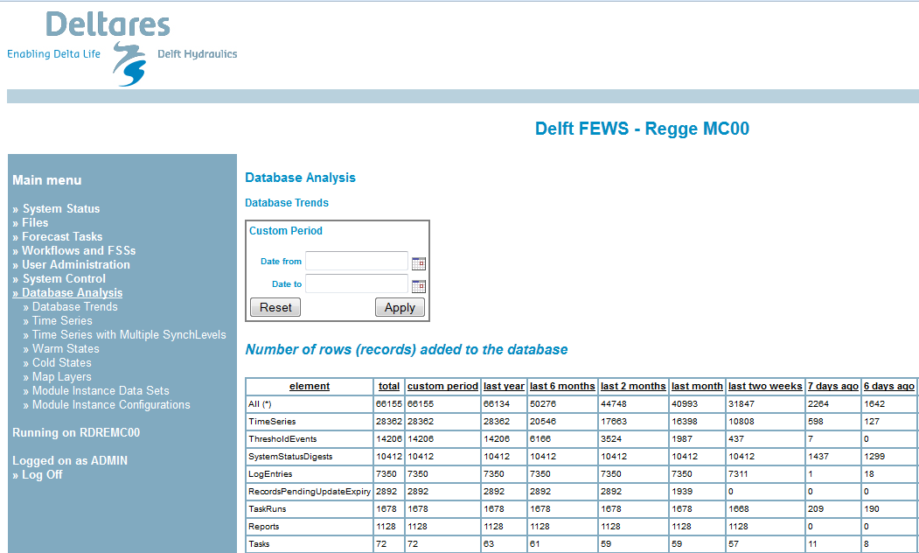
Recent Developments: Database Analysis

Slide 20
Trend Analysis – Admin Interface
How many records have been added to the database
Number of records added to (relevant) tables in the database since 1 Year, x Months, x Weeks, x Days, …
Estimate of memory usage of (relevant) tables in the database since 1 Year, x Months, x Weeks, x Days, …
How many records/bytes will be expired (and ‘rolling barreled’)….
Number of records which will be removed from (relevant) tables of the database within x Days, x Weeks, x Months, 1 Year from now…
Estimate of available memory caused by removal of records from (relevant) tables of the database within x Days, x Weeks, x Months, 1 Year from now…
Option to add a user-defined period.

Slide 21
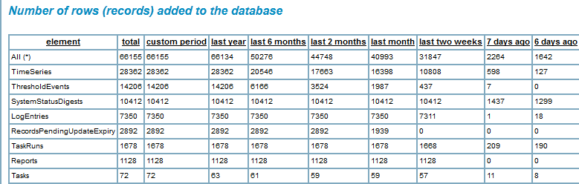
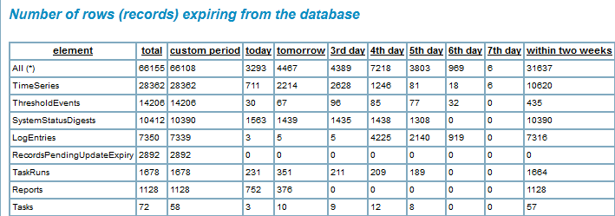
Trend Analysis – Admin Interface

Slide 22
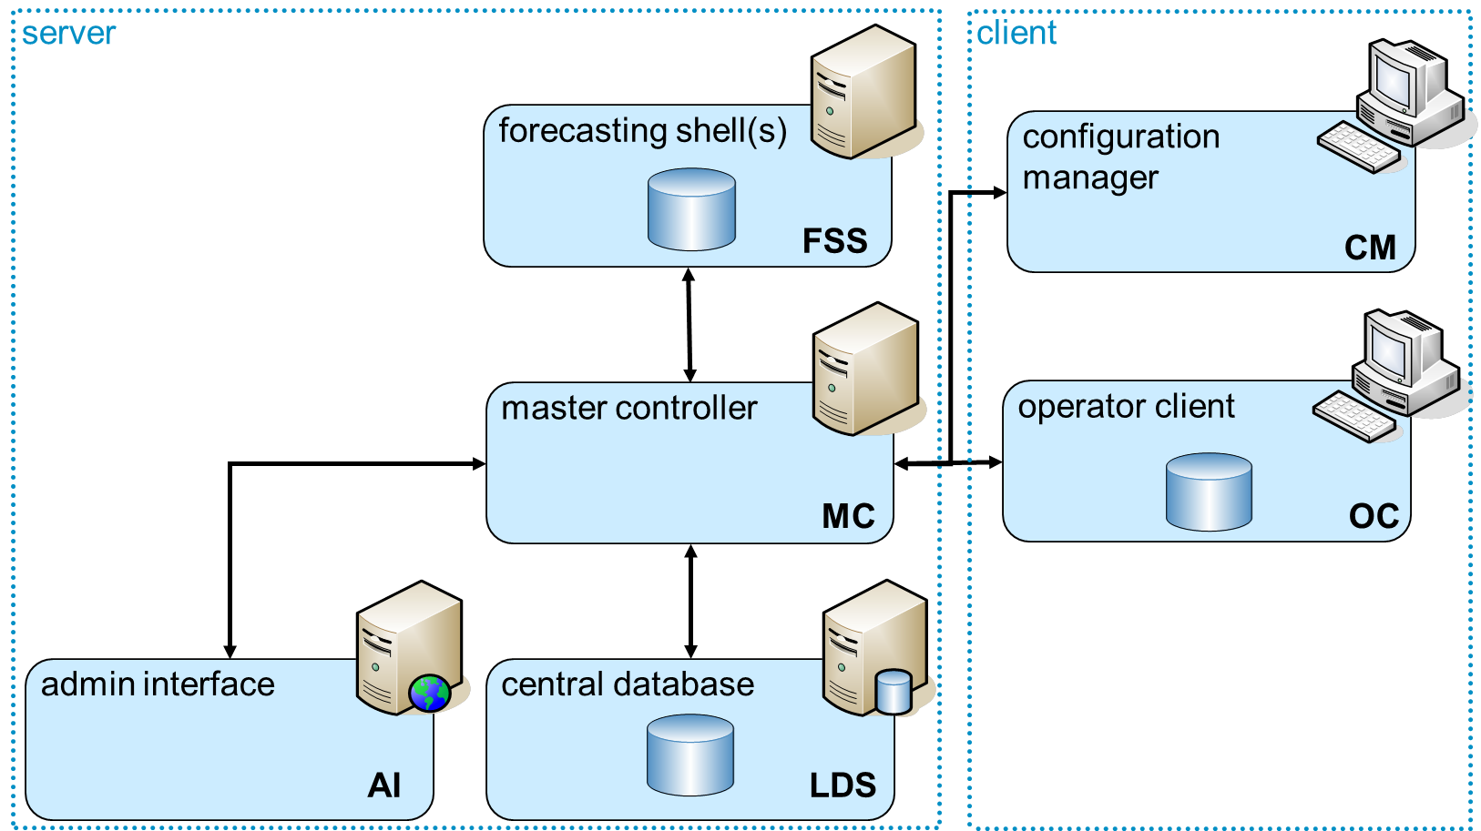
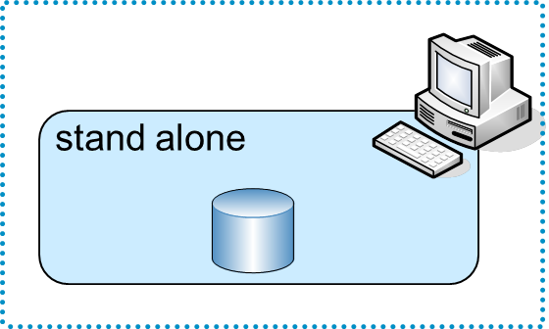
Delft-FEWS Configuration Stand alone vs Operational environment
Configuration
Database
Stored in different tables
in operational environment
OR
File System (+ directory structure)
Stored in different files
Ordered in subdirectories
during development/testing

Slide 23
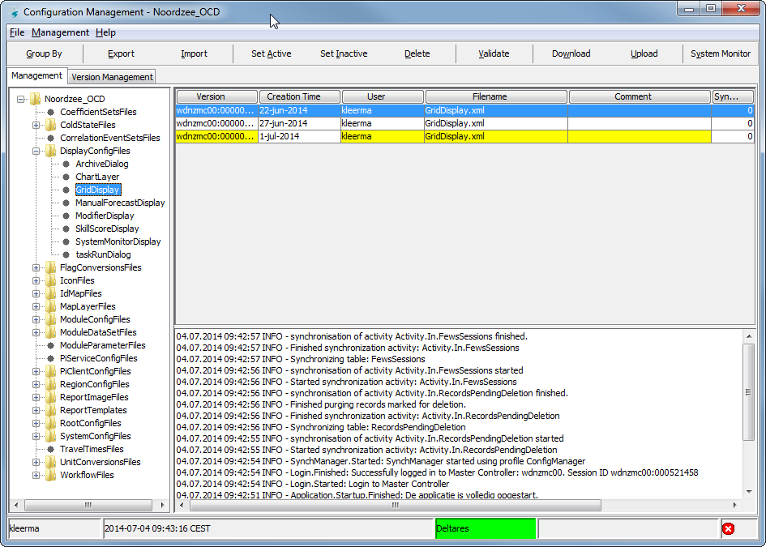
Tools – FEWS Configuration Manager

Slide 24
Configuration Manager
A special version of an operator client
Different GUI
Objective: Version Management of Configuration Files
Import (new or updated) individual files, folders or a complete /Config/ directory
Upload to Central Database

Slide 25
Tools – Configuration Manager
Management of the configuration files
To the central database
update XML-files
import to OC
set files (in-)active validate changes
upload config change to MC
To the file system
download configuration to OC
export from OC to file system
go to 1
central database
e.g. oracle
5
4
user
local datastore
3
OC
6
2
files
1

Slide 26
Patch Mechanism (OC/FSS)
A patch (e.g. 2014.01_Patch.jar) is a piece of code-fixes which is treated as ‘configuration file’ in the rootConfigFiles directory
Is distributed like all other configuration files
Import into Config Manager
Upload to Master Controller/Central Database
Downloaded in the next run to all FSSs
Downloaded to every OC which is logging on (ask for restart)

Slide 27
Optimizing your configuration
Monitoring
Configuration aspects (expiry time, synchLevel, valueResolution)
Maintenance Workflows
Amalgamate

Slide 28
Monitoring
Using the tools in the Admin Interface we can monitor database usage of a live system
But how can we optimize this (with regard to performance)?

Slide 29
TimeSeries in a Client-Server system
A FEWS Client Server System uses the same configuration as a Stand
Alone system
When updating the configuration of a FEWS application, always use the Stand Alone system
It is good to know how the Client-Server FEWS system works
The configation has some special features with respect to:
Synchronisation
Expiry time
Precision used to store the data

Slide 30
Time Series Sets
Properties of time series:
location Id – or – locationSetId
parameter Id
timestep
relativeViewPeriod
valueType (scalar, grid, profile, ..)
timeSeriesType (external historical, external forecast, ..)
moduleInstanceId (import, PDM, KW, ISIS, ..)
readWriteMode
expiryTime (when to delete from database)
synchLevel
simple transformations (delay, multiplier, divider, incrementer)
ensembleId

Slide 31
Limits of FEWS Databases
Central database – ORACLE, PostGress, SQLServer
No size limit
Forecasting Shell databases
Microsoft ACCESS: 2 GB size limit
Firebird: No size limit
Operator client databases
Microsoft ACCESS: 2 GB size limit
Firebird: No size limit
Of course: performance will reduce when database is larger

Slide 32
Expiry Times
The total volume of data in the database can be reduced by :
Configuring the expiry time
Reducing the number of decimals for data values
Mark time series as temporary data (not synchronised)
The maintenance task RollingBarrel deletes all expired data
From the Central database (every 30 minutes)
From the Forecasting Shells (every 24 hours)
From the Operator Clients (every 30 minutes)

Slide 33
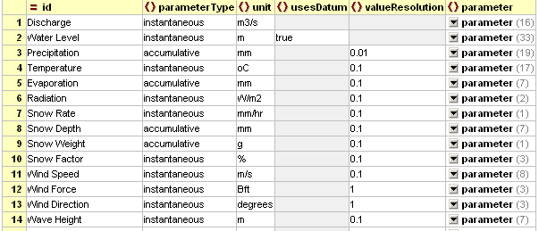
Configure valueResolution of parameters
By default a value is stored using 8 decimals
Most observed data are imported with only 2-3 decimals
The Parameters XML file allows configuration of valueResolution
This can reduce the size of the data volume considerably

Slide 34
Database size and synchronisation optimisation
Size of the database is mainly determined by:
Size of the Simulated Forecast time series or External Forecast time series
Number of forecast runs a day
Length of time a forecast is held in the database (expiryTime)
Observed grids
Size of Simulated Forecast time series can be limited by:
Change Expiry Time for less important time series or grids
Not synchronising or storing all time series, only what you want to see on the OC
Use valueResolution for parameter groups
Size of Observed Gridded Data can be limited by:
Cut-out the area of interest

Slide 35
Maintenance Workflows: Rolling Barrel
Each time series in FEWS has an associated expiry time. Once this expiry time is exceeded, this time series will be removed from the database by means of a mechanism called the Rolling Barrel
For the OC (client) the rolling barrel runs at start-up/shutdown, with a pre-set interval, or can be disabled
For the Forecasting Shells and Central Database, the Rolling Barrel should be setup as a scheduled task

Slide 36
Maintenance Workflows: markedRecordManager
The MarkedRecordManager task has to be run on the Forecating Shells and Central Database to remove database records that have been marked for deletion. The MarkedRecordManager should be setup as a scheduled task.

Slide 37
Amalgamate
Time series are stored in the FEWS database as blobs (“Binary Large OBSjects”; collection of data stored as a single entity in the database)
Regular data imports can generate a large number of small blobs
Because of this, the number of records in the database can become very large
This can degrade performance of the database
The Amalgamate module in FEWS can combine many smalls blobs into larger smaller number of larger blobs, thus reducing the number of records in the database. This Amalgamate module can be run as a regular scheduled task.

Slide 38
Advanced Topics
Multi MC Systems
Duty-standby
Event-action configuration

Slide 39
Multiple MC systems
An operational (forecasting) can exist of more than one MC(+FSSs+CDB)
Duty (MC00) and Standby (MC01). MC01 takes over when MC00 is ‘down’. If MC00 recovers, MC00 is ‘duty’ again.
This can be extended to MC03, MC04. Order which MC takes over is configurable;
The arrows mean ‘MC to MC synchronisation’ (every 5 min, hot standby)
Sometimes a MC-system is only ‘receiving’ (pulling) data e.g. for test or research
MC00
Amsterdam
MC01
Delft
MC03
Rotterdam

Slide 40
Event – Action Configuration
MC can react on a log message
- Increased frequency of Forecasts (e.g. every 3 instead of every 12 hours.)
- Export data after a new Current Forecast becomes available.

